Slide 1
SW 6th Ave. Fairlawn to Gage
City of Topeka
Trafficway Improvement Project
#T-701013.00
2017 & 2018

Slide 2
Presenters
Bartlett & West
Brian Armstrong
Jeff Lolley
Brian Austin
Cory Schoffelman
Shane Goff
City of Topeka
Jason Peek
Brian Faust
Jeff Hunt
Paul Bodner
Kasim Azhar
Joe Singer

Slide 3
Project Highlights
6th Ave. widening from Fairlawn to Gage
2 through lanes with a center turning lane
10’ side path along north side of 6th Ave. from Fairlawn to Westchester, also from east Zoo entrance to Gage
Storm sewer to eliminate drainage ditches
Pedestrian crossing with flasher at 6th & Westchester

Slide 4
Utility Relocation Work 2017
Water, Gas, and Fiber Optic Lines to begin relocation efforts in Spring 2017
Cox Cable above ground utilities relocated

Slide 5
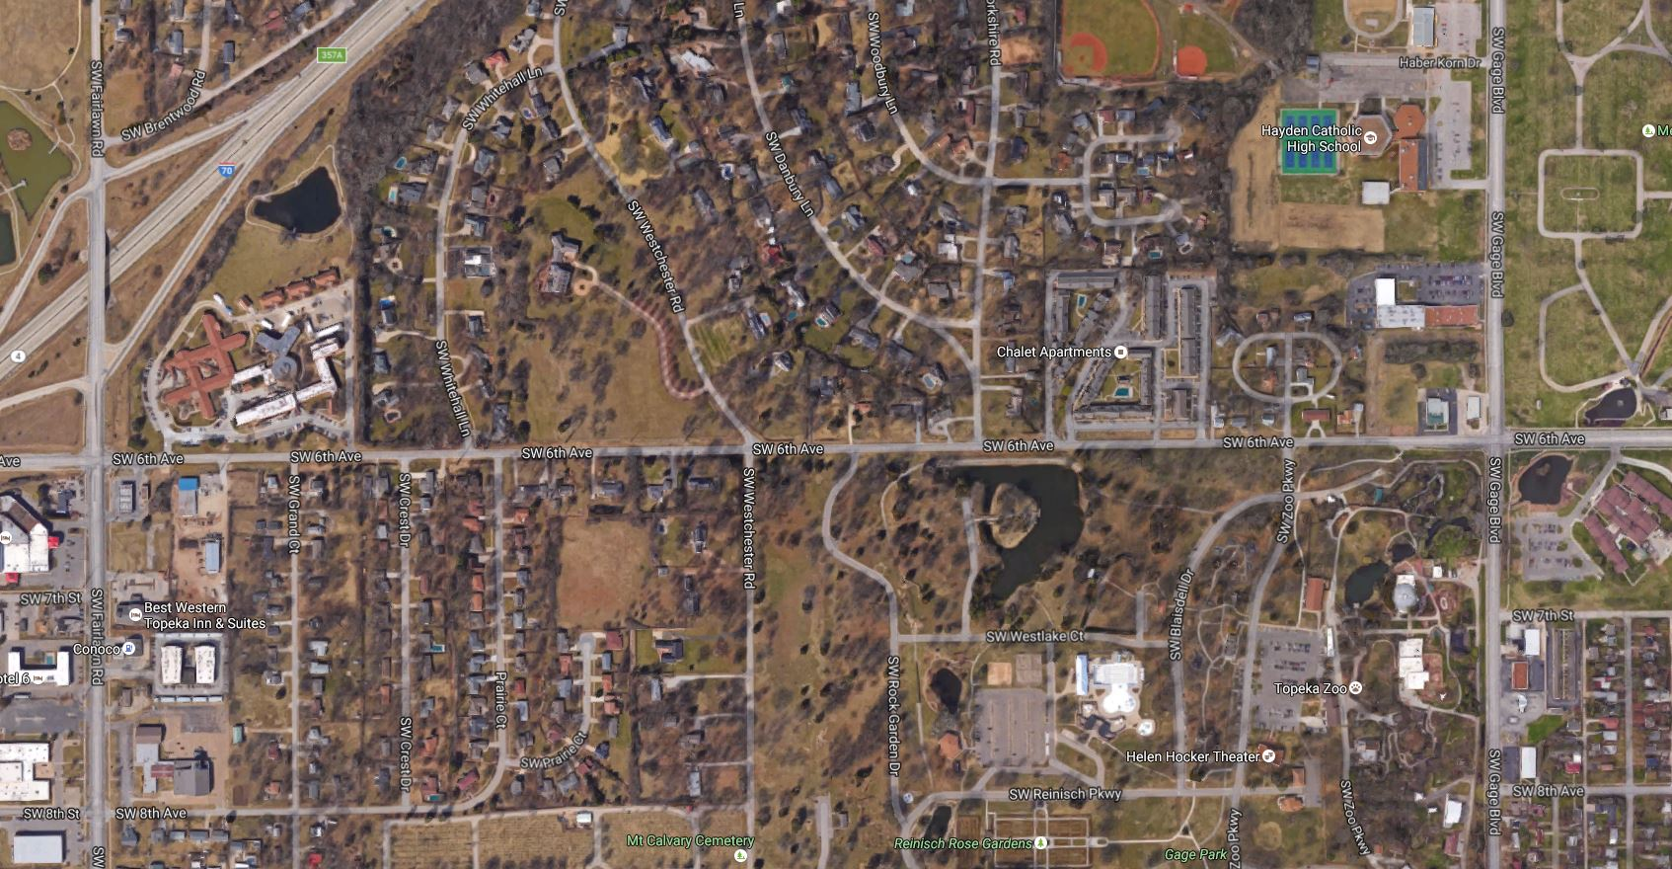
Construction – 2017 & 2018
2017 Proposed Construction
Phase I – 6th Ave. closed from Schendel east to Westchester Rd.
Phase II – 6th Ave. closed from Fairlawn to Schendel
Estimated timeframe – 6 months
2018 Proposed Construction
Phase III – 6th Ave. closed from Westchester Rd. east to Chalet Apartments
Phase IV – 6th Ave. closed from Chalet Apts. to Gage
Estimated timeframe – 8 months

Slide 6
2017 Construction – 10th Ave.

Slide 7
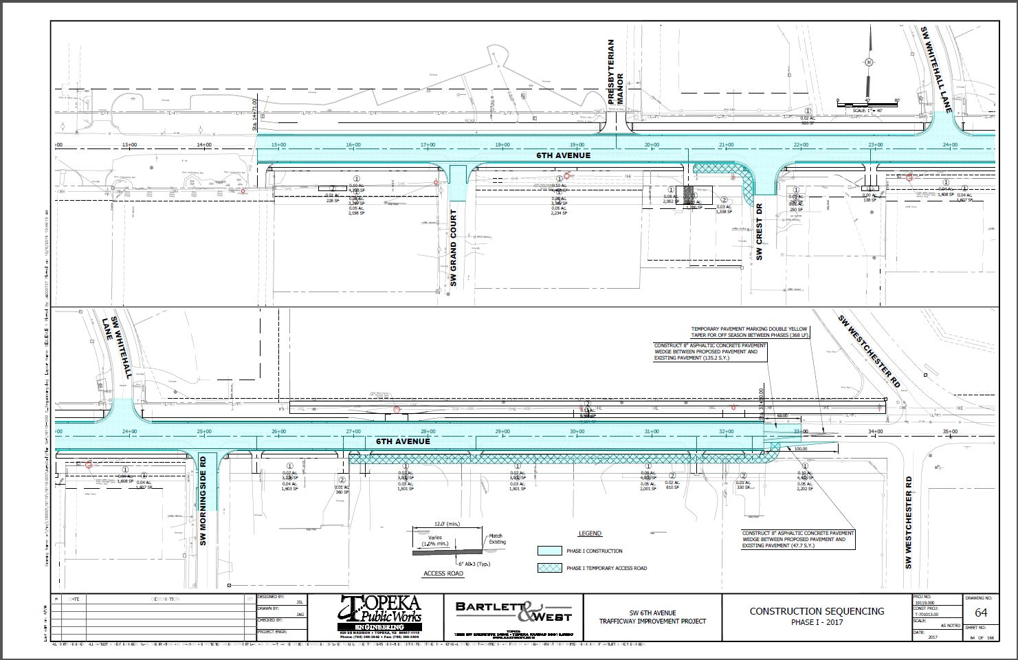
2017 Construction – 6th Ave.

Slide 8
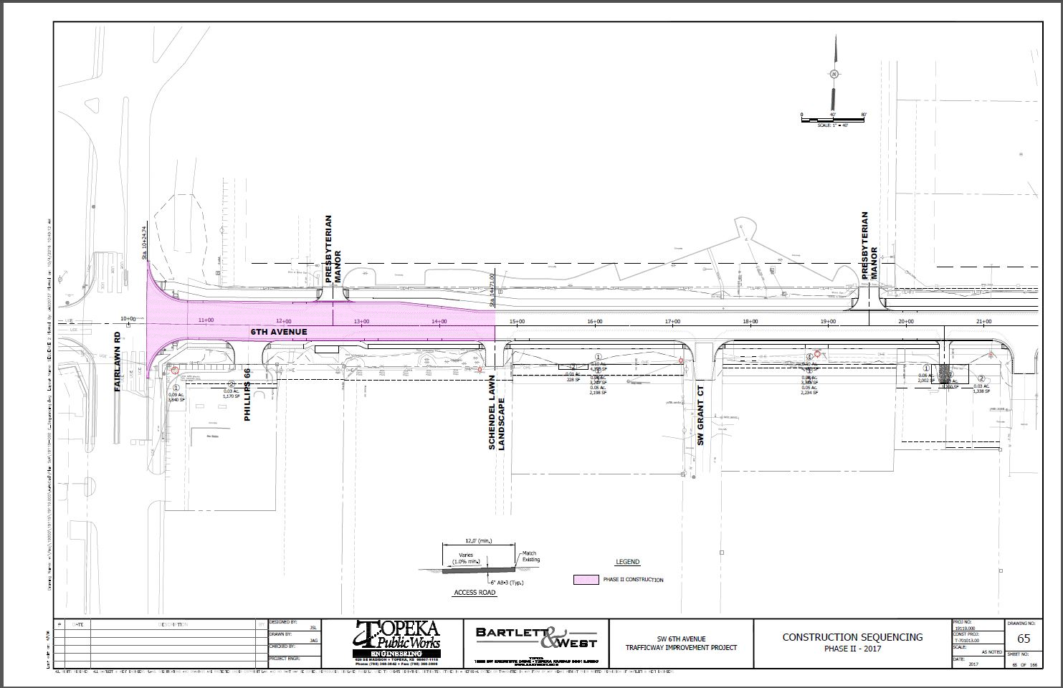
2017 Construction – 6th Ave.

Slide 9
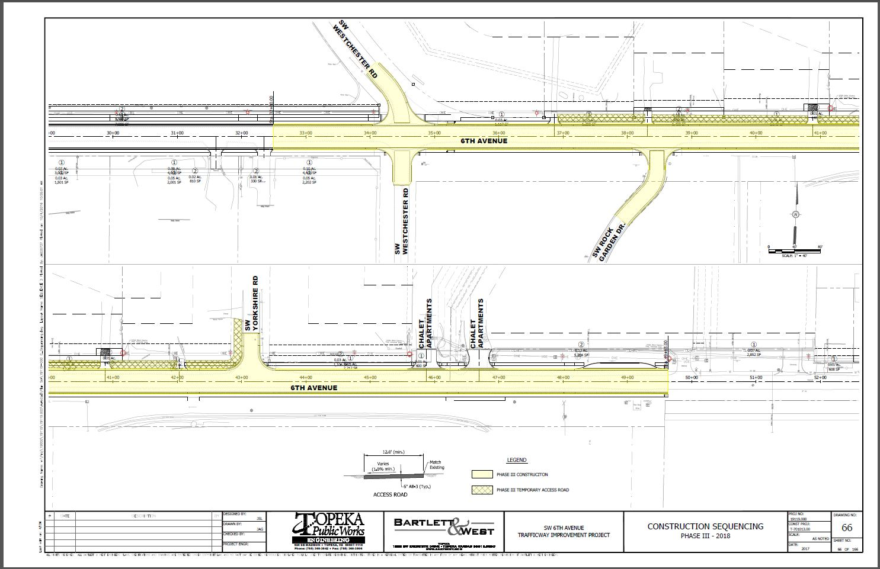
2018 Construction – 6th Ave.

Slide 10
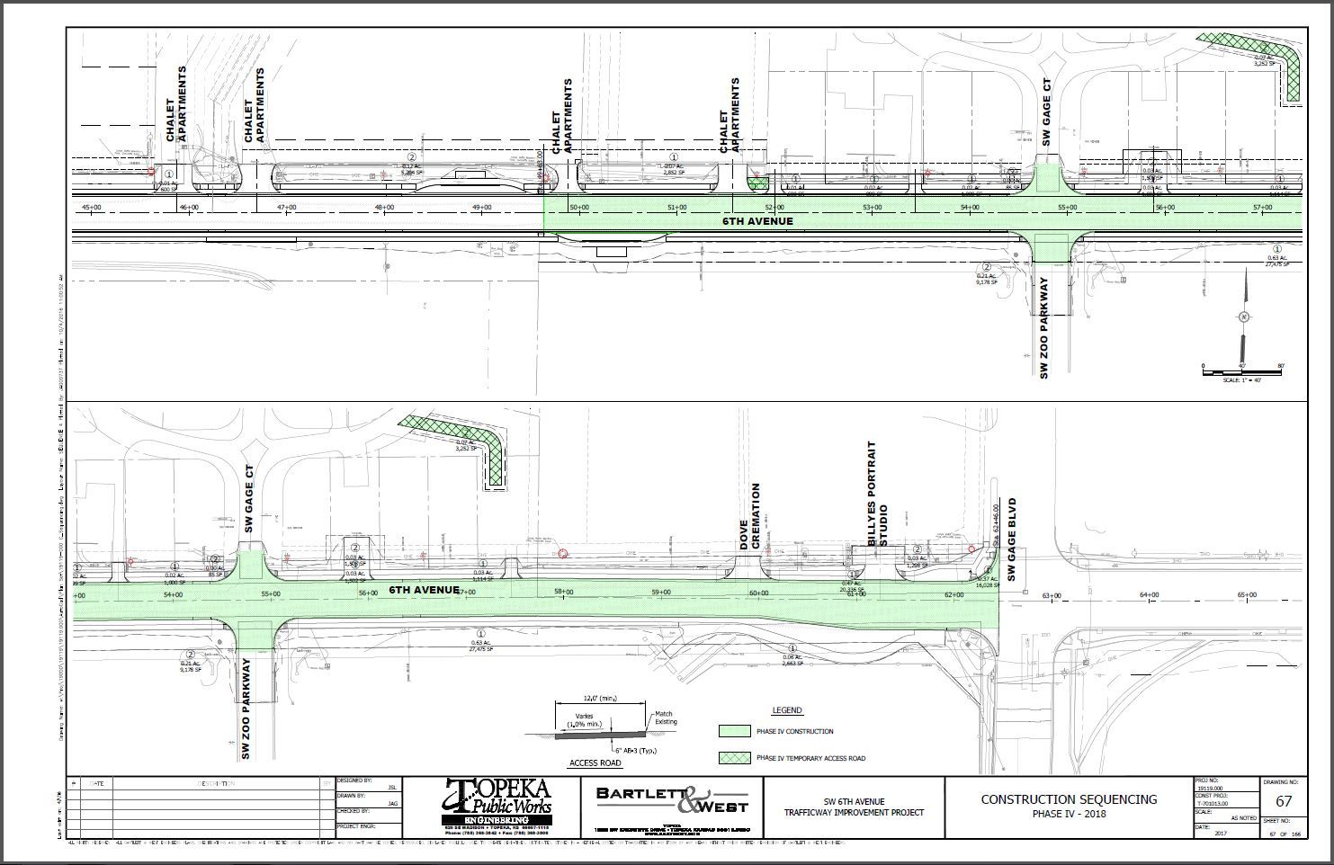
2018 Construction – 6th Ave.

Slide 11
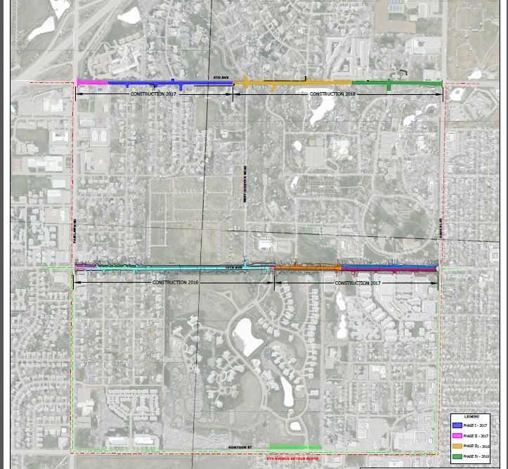

Slide 12
Access During Construction
Temporary Access Road

Slide 13
Project Contacts
City of Topeka
Bartlett & West
Jeff Hunt
785.368.3842
Brian Faust
785.368.3842
Brian Armstrong
785.272.2252
Jeff Lolley
785.272.2252

Slide 14
Following the Presentation
Four Display Stations
Two displays with proposed sequencing of construction
Two displays with 2017 and 2018 detours
Members of City of Topeka and Bartlett & West available for discussion

